Slide 1

Decentralized Judging System
Bit Rebels
RACHIT SRIVASTAVA
APOORV LATHEY

Slide 2
“
JUSTICE DELAYED IS JUSTICE DENIED
”

Slide 3
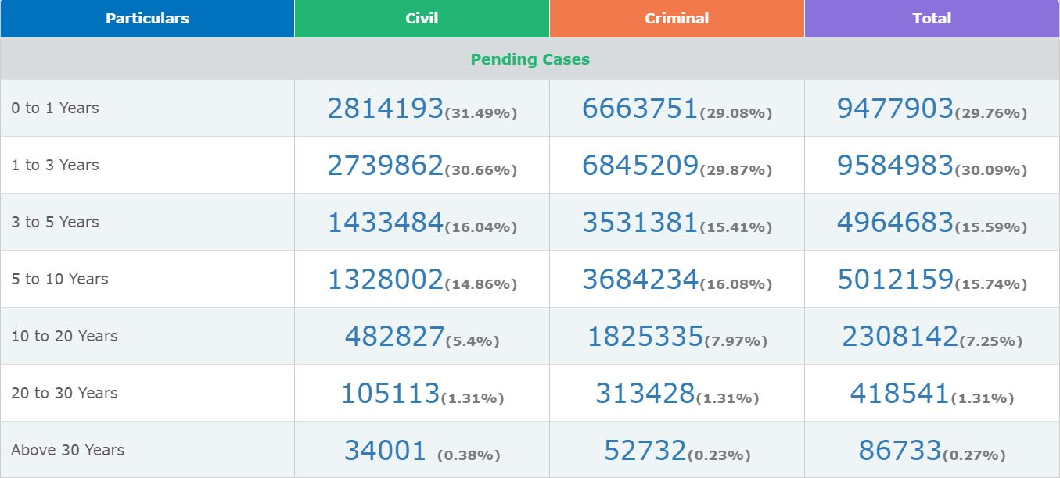
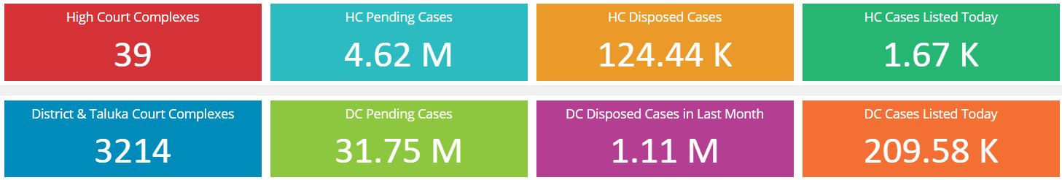

Slide 4
Our Solution
JUSTICE AT YOUR DOORSTEP
NO POLITICAL INTERFERENCE
PROTECTION OF LIFE OF WITNESS
SAVING MONEY OF THE TAXPAYER
IMPROVING INDIAN JUDICIARY
A STEP TOWARDS DIGITAL INDIA
Notes:
<number>

Slide 5
SECURED IMPLEMENTATION
OUR SYSTEM UTLIZES THE LIVEPEER PROTOCOL FOR VIDEO CONFERENCING.
EVIDENCE IS STORED BY UTILIZING IPFS AND FILECOIN, HENCE SECURELY ENCYPTED AND
SAFE FROM MANIPULATION.
Court fees from suspect & victim put in contract & deposited to Aave. Whoever wins gets
the interest accumulated. Court gets paid only when case ended .
NuCypher → Encrypt sensitive info/evidences accessible to specific parties only
(lawyers, judge

Slide 6
Internet Reliability
Witnesses Related To Criminal Cases Can Go To The Nearby District Or High Court Where E-court Rooms Are Already In Place Or To The It Cell Of The District Magistrate’s Office, And Indian Embassy In Case Of Foreign Nationals After Getting It Approved By The Judge.
Civil Cases can be handled from home.
Witness can give their statement from their home/any safe place while the prisoner’s statement can be recorded from the prison.
MULTI-LINGUAL LANGUAGE SUPPORT
Notes:
<number>

Slide 7
SAVING TAXPAYER’S MONEY
RS. 1000 PER INMATE IS SPENT AND THERE ARE TOTAL 46 LAKHS INMATES ARE TRANSPORTED EVERY YEAR FOR COURT HEARINGS. OUR PROJECT WILL SAVE AROUND RS 460 CRORE.
PROTECTION OF A WITNESS IS VERY IMPORTANT BUT IT COMES
WITH A HUGE COST IT COSTS APPROXIMATELY 4-5 LAKH TO
PROTECT JUST ONE WITNESS FOR A YEAR

Slide 8
WITNESS PROTECTION
IN SPECIAL LAWS THE LEGILATURE INCLUDING :
TERRORIST AND DISRUPTIVE ACTIVITIES ACT,1985
PREVENTION OF TERRORISM ACT,2002
WHISTLEBLOWER PROTECTION ACT,2014
UNLAWFUL ACTIVITIES PREVENTION AMENDMENT ACT,2019
THERE ARE AROUND 51,000 COMPLAINTS REGISTERED YEARLY AGAINST THE
POLICE OFFICERS IN CHARGE OF THE PROTECTION OF THE WITNESS

Slide 9
THOSE SPECIAL CASES THAT ARE NEVER REGISTERED MAY BE DUE TO ANYTYPE OF FEAR CAN GET JUSTICE.

Slide 10
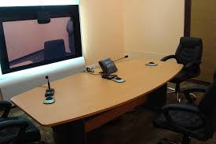
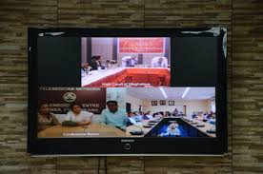
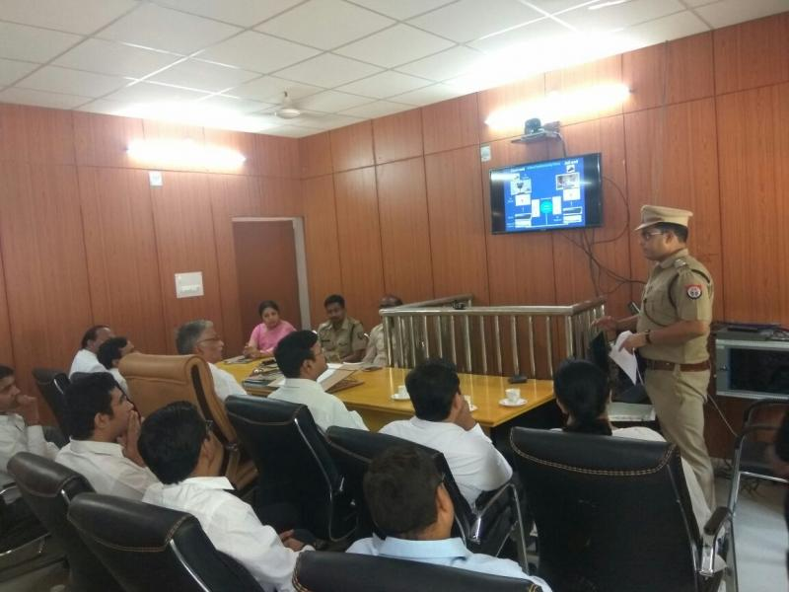
INFRASTRUCTURE ALREADY AVAILABLE

Slide 11
A BIG RELIEF TO RAPE VICTIMS
“SECTION 228-A OF THE INDIAN PENAL CODE MAKES DISCLOSURE OF IDENTITY OF A VICTIM IN SEXUAL ASSAULT CASES A PUNISHABLE CRIME, WHICH DETERS THE MEDIA FROM TAKING THE NAME PUBLICILY”
THE DECISION OF GIVING THE ACCESS OF NAME AND FACE OF THE VICTIM WILL BE TAKEN BY THE JUDGE.
2) THE POLICE FIR AND THE MEDICAL REPORT WILL BE AVAILABLE PRIOR TO THE JUDGES.
3) IT WILL PREVENT POLITICISATION OF ANY SORT OF SUCH HENIOUS CRIMES.

Slide 12


